Slide 1

External Format Processing
Parsing JSON, JSON.NET
SoftUni Team
Technical Trainers
Software University
http://softuni.bg

Slide 2
Table of Contents
JSON Data Format
Processing JSON
JSON.NET

Slide 3
Have a Question?
sli.do
#CSharpDB

Slide 4
{JSON}
The JSON Data Format
Definition and Syntax

Slide 5
JSON Data Format
JSON (JavaScript Object Notation) is a lightweight data format
  Human and machine-readable plain text
  Based on JavaScript objects
  Independent of development platforms and languages
  JSON data consists of:
    Values (strings, numbers, etc.)
    Key-value pairs: { key : value }
    Arrays: [value1, value2, …]

Slide 6
JSON Data Format (2)
The JSON data format follows the rules of object creation in JS
  Strings, numbers and Booleans are valid JSON:
  Arrays are valid JSON:
  Objects are valid JSON (key-value pairs):
"this is a string and is valid JSON"
3.14
true
[5, "text", true]
{
"firstName": "Vladimir", "lastName": "Georgiev",
"jobTitle": "Technical Trainer", "age": 25
}

Slide 7
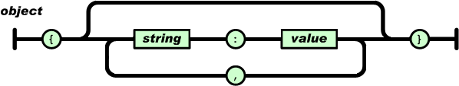
JSON Object
An object is an unordered set of name/value pairs. An object
begins with { (left brace) and ends with } (right brace). Each
name is followed by : (colon) and the name/value pairs are
separated by , (comma)

Slide 8
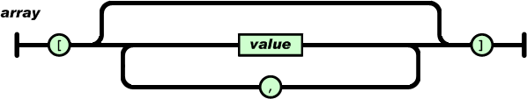
JSON Array
An array is an ordered collection of values. An array begins with [ (left bracket) and ends with ] (right bracket). Values are
separated by , (comma)

Slide 9
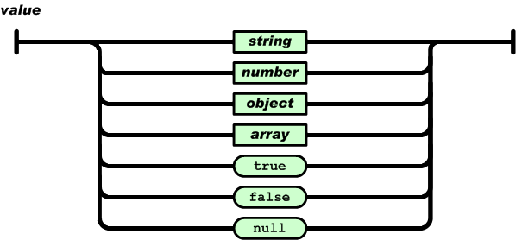
JSON Value
A value can be a string in double quotes, or a number, or true or false or null, or an object or an array. These structures can
be nested

Slide 10
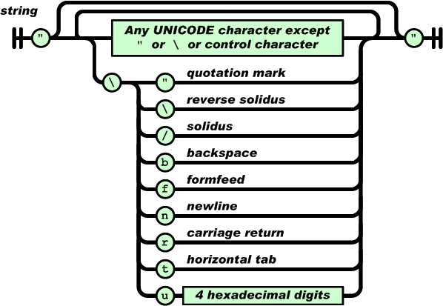
JSON String
A string is a sequence of zero or more Unicode
characters, wrapped in double quotes, using
backslash escapes. A
character is represented as a single character
string

Slide 11
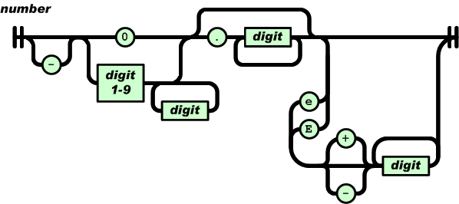
JSON Number
A number is very much like a C or Java number, except that the octal and hexadecimal formats are not used

Slide 12

{JSON}
Processing JSON
Parsing JSON in C# and .NET

Slide 13
Built-in JSON Support
.NET has a built-in DataContractJsonSerializer class
Contained in System.Runtime.Serialization
assembly
Supports deserializing (parsing) strings and
serializing objects
Including DataContractJsonSerializer into a project:
using System.Runtime.Serialization.Json;

Slide 14
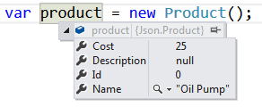
Serializing JSON
DataContractJsonSerializer can serialize an object:
static string SerializeJson<T>(T obj)
{
var serializer = new DataContractJsonSerializer(obj.GetType());
using (var stream = new MemoryStream())
{
serializer.WriteObject(stream, obj);
var result = Encoding.UTF8.GetString(stream.ToArray());
return result;
}
}
{
"Id":0,
"Name":"Oil Pump",
"Description":null,
"Cost":25
}

Slide 15
Deserializing JSON
DataContractJsonSerializer can deserialize a JSON string:
static T DeserializeJson<T>(string jsonString)
{
var serializer = new DataContractJsonSerializer(typeof(T));
var jsonStringBytes = Encoding.UTF8.GetBytes(jsonString);
using (var stream = new MemoryStream(jsonStringBytes))
{
var result = (T)serializer.ReadObject(stream);
return result;
}
}
{
"Id":0,
"Name":"Oil Pump",
"Description":null,
"Cost":25
}

Slide 16
Newtonsoft
Json.NET
JSON.NET
Better JSON Parsing for .NET Developers

Slide 17
What is JSON.NET?
JSON.NET is a JSON framework for .NET
  More functionality than built-in functionality
  Supports LINQ-to-JSON
  Out-of-the-box support for parsing between JSON and XML
  Open-source project: http://www.newtonsoft.com
  Json.NET vs .NET Serializers: https://www.newtonsoft.com/json/help/html/JsonNetVsDotNetSerializers.htm

Slide 18
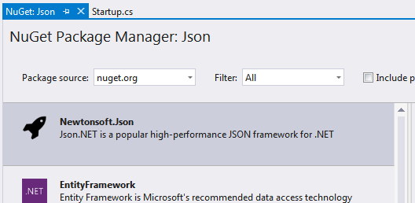
Installing JSON.NET
To install JSON.NET use the NuGet Package Manager:
Or with a command in the Package Manager Console:
Install-Package Newtonsoft.Json

Slide 19
General Usage
JSON.NET exposes a static service JsonConvert
Used for parsing and configuration
  To Serialize an object:
  To Deserialize an object:
var jsonProduct = JsonConvert.SerializeObject(product);
var objProduct =
JsonConvert.DeserializeObject<Product>(jsonProduct);

Slide 20
JSON.NET Features
JSON.NET can be configured to:
  Indent the output JSON string
  To convert JSON to anonymous types
  To control the casing and properties to parse
  To skip errors
JSON.NET also supports:
  LINQ-to-JSON
  Direct parsing between XML and JSON

Slide 21
Configuring JSON.NET
By default, the result is a single line of text
To indent the output string use Formatting.Indented
JsonConvert.SerializeObject(products, Formatting.Indented);
{
"pump": {
"Id": 0,
"Name": "Oil Pump",
"Description": null,
"Cost": 25.0
},
"filter": {
"Id": 0,
"Name": "Oil Filter",
"Description": null,
"Cost": 15.0
}
}

Slide 22
Configuring JSON.NET
Deserializing to anonymous types:
Incoming JSON
var json = @"{ 'firstName': 'Vladimir',
'lastName': 'Georgiev',
'jobTitle': 'Technical Trainer' }";
var template = new
{
FirstName = string.Empty,
LastName = string.Empty,
Occupation = string.Empty
};
var person = JsonConvert.DeserializeAnonymousType(json, template);
Template objects

Slide 23
JSON.NET Parsing of Objects
By default JSON.NET takes each property / field from the class
and parses it
  This can be controlled using attributes:
public class User
{
[JsonProperty("user")]
public string Username { get; set; }
[JsonIgnore]
public string Password { get; set; }
}
Parse Username to user
Skip the property

Slide 24
JSON.NET Parsing of Objects
By default JSON.NET takes each property / field from the class
and parses it
  This can be controlled using ContractResolver:
DefaultContractResolver contractResolver = new DefaultContractResolver()
{
NamingStrategy = new SnakeCaseNamingStrategy()
};
var serialized = JsonConvert.SerializeObject(person, new JsonSerializerSettings()
{
ContractResolver = contractResolver,
Formatting = Formatting.Indented
});

Slide 25
LINQ-to-JSON
LINQ-to-JSON works with JObjects
  Create from JSON string:
  Reading from file:
  Using JObject:
JObject obj = JObject.Parse(jsonProduct);
var people = JObject.Parse(File.ReadAllText(@"c:\people.json"))
foreach (JToken person in people)
{
Console.WriteLine(person["FirstName"]); // Ivan
Console.WriteLine(person["LastName"]); // Petrov
}

Slide 26
LINQ-to-JSON (2)
JObjects can be queried with LINQ
var json = JObject.Parse(@"{'products': [
{'name': 'Fruits', 'products': ['apple', 'banana']},
{'name': 'Vegetables', 'products': ['cucumber']}]}");
var products = json["products"].Select(t =>
string.Format("{0} ({1})",
t["name"],
string.Join(", ", c["products"])
))
// Fruits (apple, banana)
// Vegetables (cucumber)

Slide 27
XML-to-JSON
Json.NET supports converting JSON to XML and vice versa
using the XmlNodeConverter
Conversion Rules
  Elements remain unchanged.
  Attributes are prefixed with an @ and should be at the start of the object.
  Single child text nodes are a value directly against an element, otherwise they are accessed
  via #text.
  The XML declaration and processing instructions are prefixed with ?.
  Character data, comments, whitespace and significant whitespace nodes are accessed via
  #cdata-section, #comment, #whitespace and #significant-whitespace respectively
  Multiple nodes with the same name at the same level are grouped together into an array.
  Empty elements are null.

Slide 28
XML-to-JSON
{
"?xml": {
"@version": "1.0",
"@standalone": "no"
},
"root": {
"person": [
{
"@id": "1",
"name": "Alan",
"url": "www.google.com"
},
{
"@id": "2",
"name": "Louis",
"url": "www.yahoo.com"
}
]
}
}
string xml = @"<?xml version='1.0' standalone='no'?>
<root>
<person id='1'>
<name>Alan</name>
<url>www.google.com</url>
</person>
<person id='2'>
<name>Louis</name>
<url>www.yahoo.com</url>
</person>
</root>";
XmlDocument doc = new XmlDocument();
doc.LoadXml(xml);
string jsonText = JsonConvert.SerializeXmlNode(doc);

Slide 29

Summary
…
…
…
JSON is cross platform data
format
DataContractJsonSerializer is the
default JSON Parser in C#
JSON.NET is a fast framework for
working with JSON data

Slide 30
https://softuni.bg/courses/databases-advanced-entity-framework

Slide 31













SoftUni Diamond Partners

Slide 32




SoftUni Organizational Partners

Slide 33




Trainings @ Software University (SoftUni)
Software University – High-Quality Education and
Employment Opportunities
  softuni.bg
Software University Foundation
  http://softuni.foundation/
Software University @ Facebook
  facebook.com/SoftwareUniversity
Software University Forums
  forum.softuni.bg

Slide 34

License
This course (slides, examples, demos, videos, homework, etc.)
is licensed under the "Creative Commons Attribution-NonCommercial-ShareAlike 4.0 International" license

